Slide 1
GSEA Tutorial

Slide 2
Presentation Outline
What is GSEA?
How to use GSEA?
GSEA R versions
Samples used
Demo

Slide 3

GSEA overview
Subramanian, A., Tamayo, P., Mootha, V. K., Mukherjee, S., Ebert, B. L., Gillette, M. A., Paulovich, A., Pomeroy, S. L., Golub, T. R., Lander, E. S. & Mesirov, J. P. (2005) Proc. Natl. Acad. Sci. USA 102, 15545-15550. Gene set enrichment analysis: A knowledge-based approach for interpreting genome-wide expression profiles

Slide 4
Gene Set Enrichment Analysis (GSEA)
Given a predefined set of genes and measurement of expression from prior experiments (microarray or RNA-seq), GSEA determines if this set of genes (ranked by degree of correlation to a phenotype or disease ) is enriched or over reprented

Slide 5
Advantages of GSEA
Operates on any ordered gene list
Does not require a gene selection threshold or a statistically significant marker set
Preserves “biological” correlation to gene markers due to permutation of phenotype labels
Distribution-free, non-parametric, permutation-based test procedures with increased statistical power

Slide 6
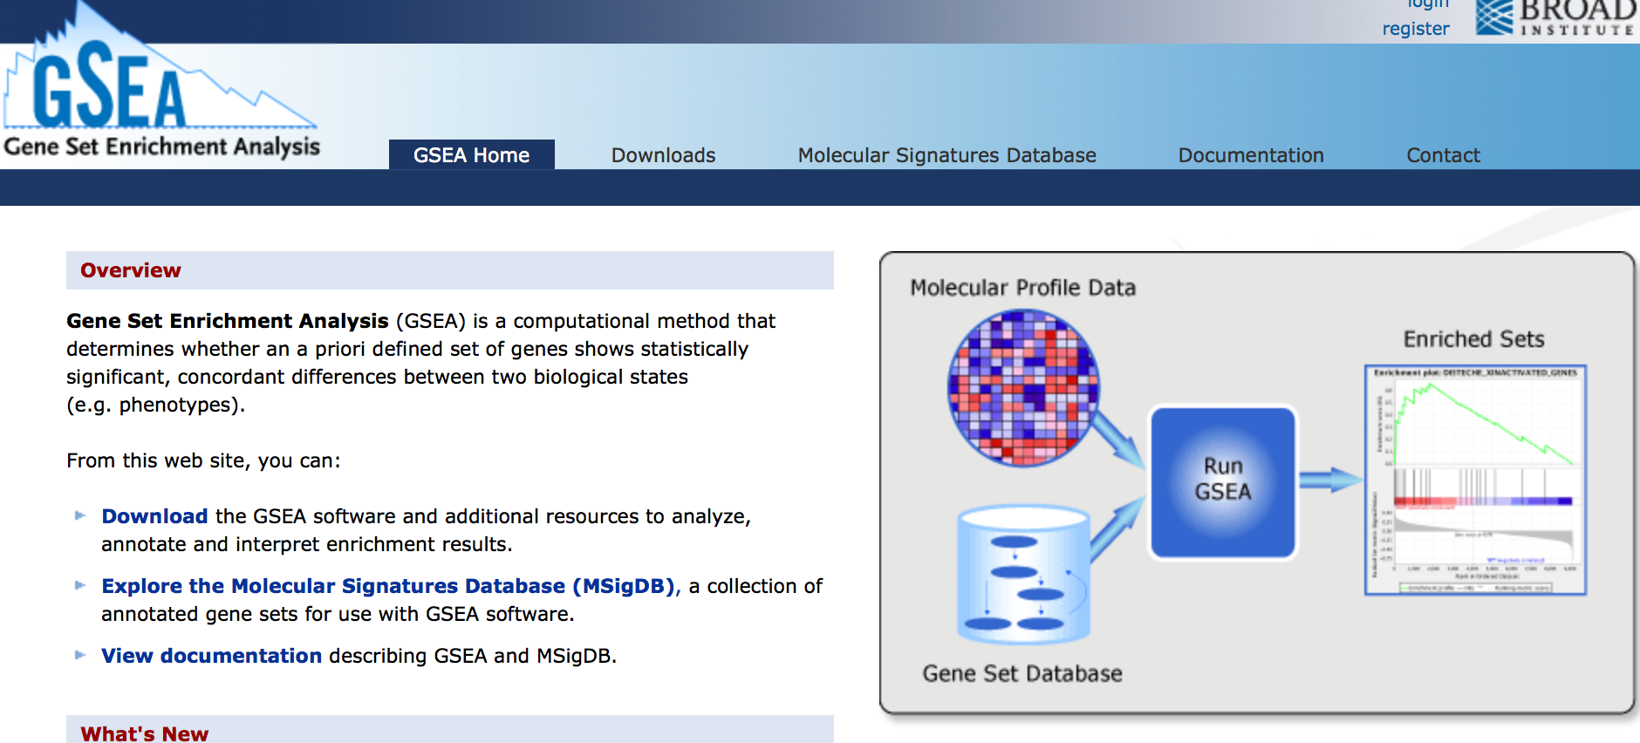
GSEA Broad Institute (MIT)
http://www.broadinstitute.org/gsea/index.jsp

Slide 7
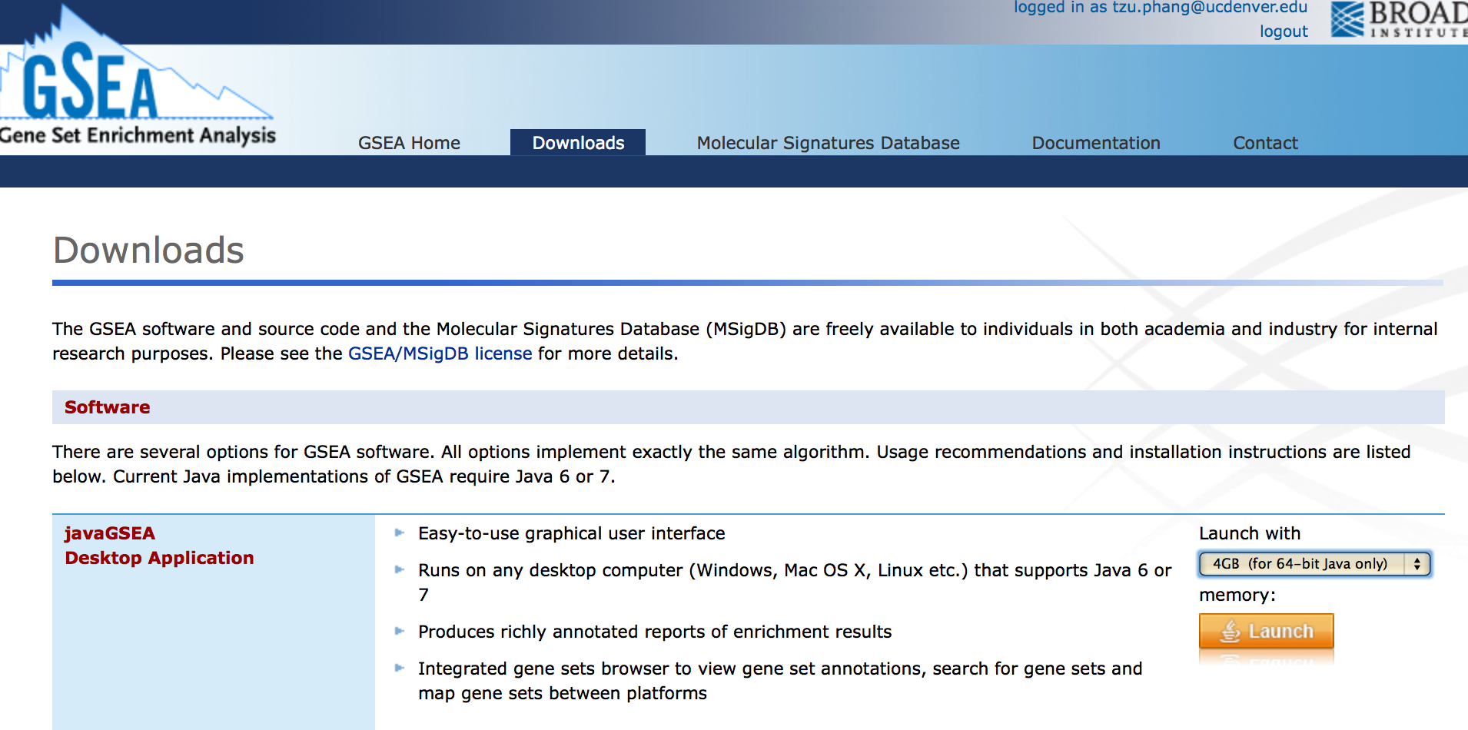
GSEA download

Slide 8
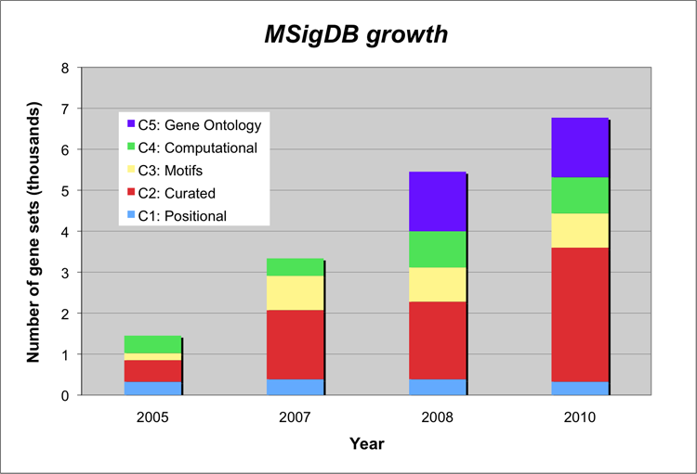
MSigDB Genes
GSEA uses gene sets from MSigDB
As of 2019 there are 12593 gene sets
http://software.broadinstitute.org/gsea/msigdb

Slide 9
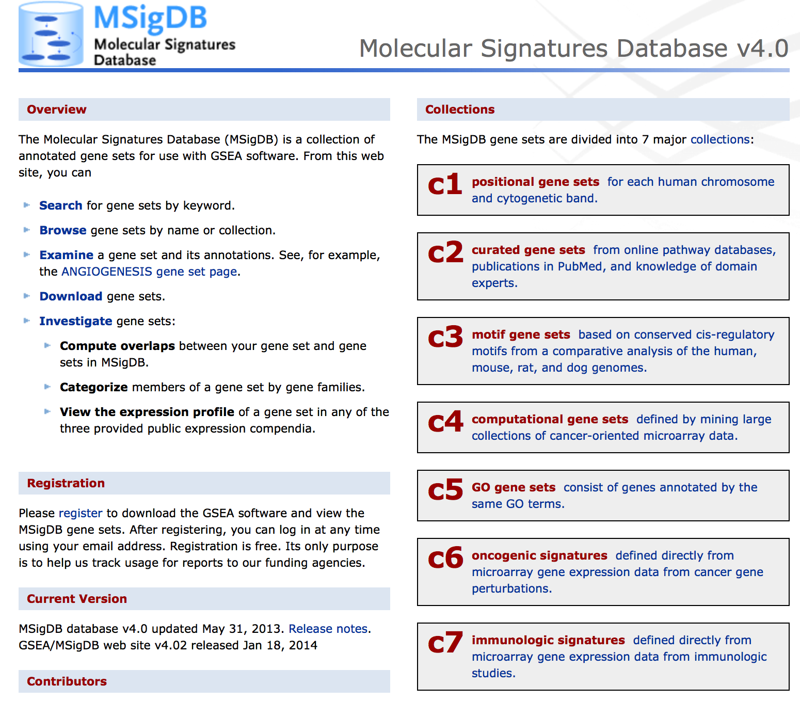

Slide 10

GSEA algorithm and Enrichment Score
Highly expressed in diseased
Diseased
Normal
Genes on the left side are highly expressed on the top half (indicated by red color) and lowly expressed on the bottom half (indicated by blue color). The reverse is shown on the right-most genes
Created a gradient or ranked list corresponding to the degree of correlation with the two phenotypes
Lowly expressed in diseased

Slide 11
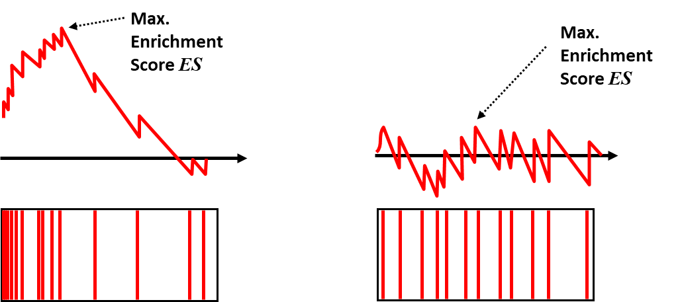
GSEA algorithm and Enrichment Score
Enriched Gene Set Example
Unenriched Gene Set Example
The algorithm compares the ranked gene list with gene set (from MutSigDB or user defined) and an Enrichment Score (ES) is generated
Every hit go up by 1/N_{H}
Every miss go down by 1/N_{M}
The maximum height is the enrichment score

Slide 12
R packages to do GSEA
fgsea
https://bioconductor.org/packages/release/bioc/html/fgsea.html
GSEABase
https://bioconductor.org/packages/release/bioc/html/GSEABase.html
fgsea
https://bioconductor.org/packages/release/bioc/html/fgsea.html

Slide 13
Fgsea example
*fgsea requires a preranked set of genes (based on expression or experimental parameters)
BiocManager::install(“fgsea") #install fgsea
library(fgsea) #load fgsea
data(examplePathways) #load example data or use your own files in .rnk format or .gmt
data(exampleRanks)
rnk.file <- system.file("extdata", "naive.vs.th1.rnk", package="fgsea")
gmt.file <- system.file("extdata", "mouse.reactome.gmt", package="fgsea")

Slide 14
Fgsea example
If using .rnk or .gmt (not example files) need to load the ranked genes and gene pathways
ranks <- read.table(rnk.file, #loading ranks
header=TRUE, colClasses = c("character", "numeric"))
ranks <- setNames(ranks$t, ranks$ID)
str(ranks)
pathways <- gmtPathways(gmt.file) #loading pathways
str(head(pathways))

Slide 15
Fgsea example
*next steps are the same whether using example data or your own experimental data
fgseaRes <- fgsea(pathways = examplePathways, #running gsea
stats = exampleRanks,
minSize=15,
maxSize=500,
nperm=10000)
head(fgseaRes[order(pval), ]) #results and p-values can be looked at in a table
sum(fgseaRes[, padj < 0.01]) #How many hits were significant at below given p value
plotEnrichment(examplePathways[["5991130_Programmed_Cell_Death"]], #enrichment plot for specific
exampleRanks) # pathway
topPathwaysUp <- fgseaRes[ES > 0][head(order(pval), n=10), pathway] #tableplot of multiple
topPathwaysDown <- fgseaRes[ES < 0][head(order(pval), n=10), pathway] #pathways
topPathways <- c(topPathwaysUp, rev(topPathwaysDown))
plotGseaTable(examplePathways[topPathways], exampleRanks, fgseaRes,
gseaParam = 0.5)

Slide 16
Fgsea example
*next steps are the same whether using example data or your own experimental data
fgseaRes <- fgsea(pathways = examplePathways, #running gsea
stats = exampleRanks,
minSize=15,
maxSize=500,
nperm=10000)
head(fgseaRes[order(pval), ]) #results and p-values can be looked at in a table
sum(fgseaRes[, padj < 0.01]) #How many hits were significant at below given p value
plotEnrichment(examplePathways[["5991130_Programmed_Cell_Death"]], #enrichment plot for specific
exampleRanks) # pathway
topPathwaysUp <- fgseaRes[ES > 0][head(order(pval), n=10), pathway] #tableplot of multiple
topPathwaysDown <- fgseaRes[ES < 0][head(order(pval), n=10), pathway] #pathways
topPathways <- c(topPathwaysUp, rev(topPathwaysDown))
plotGseaTable(examplePathways[topPathways], exampleRanks, fgseaRes,
gseaParam = 0.5)

Slide 17
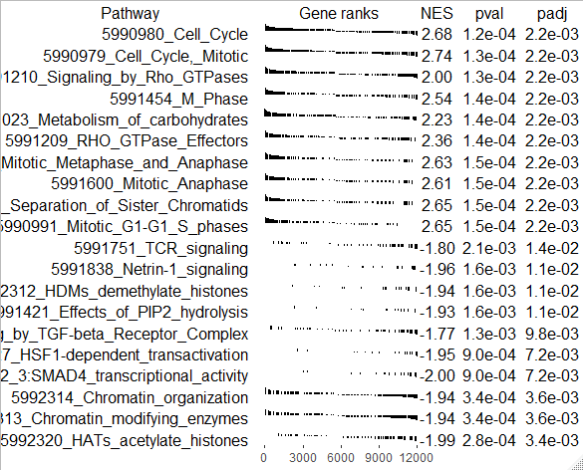
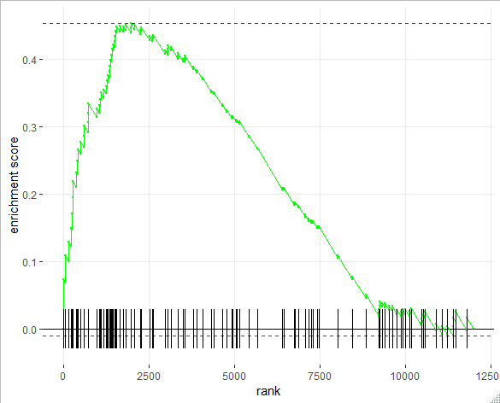
Fgsea example
Example table-plot from previous code
Example Enrichment plot
from previous code (programmed cell
death pathway)

Slide 18
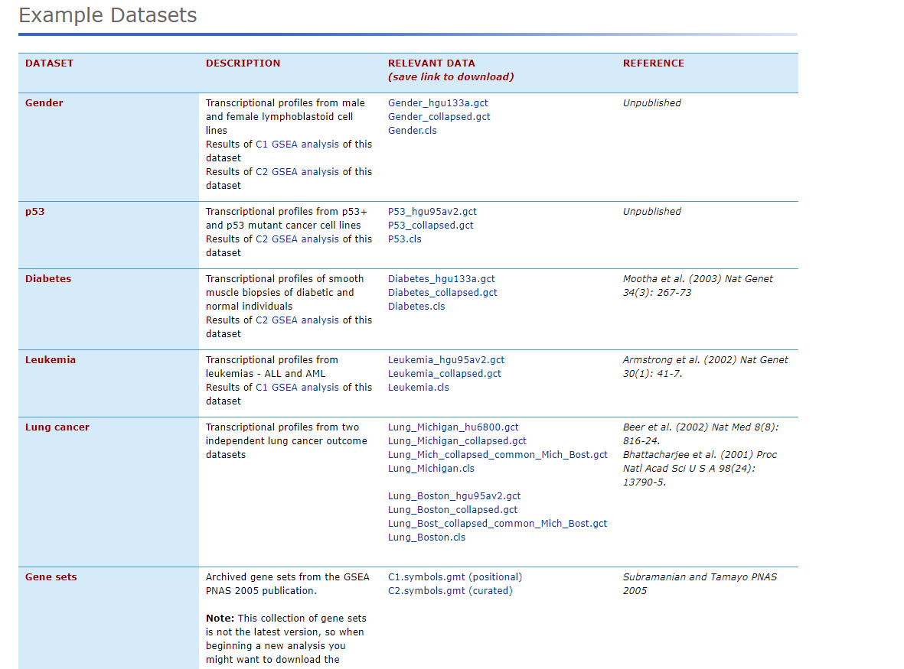
Example Datasets

Slide 19
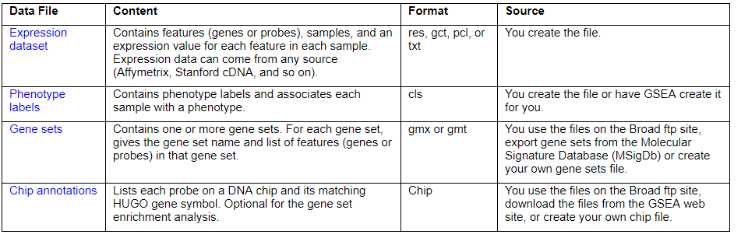
Preparing Input files for GSEA
*Only required for Microarray data
https://software.broadinstitute.org/gsea/doc/GSEAUserGuideFrame.html

Slide 20
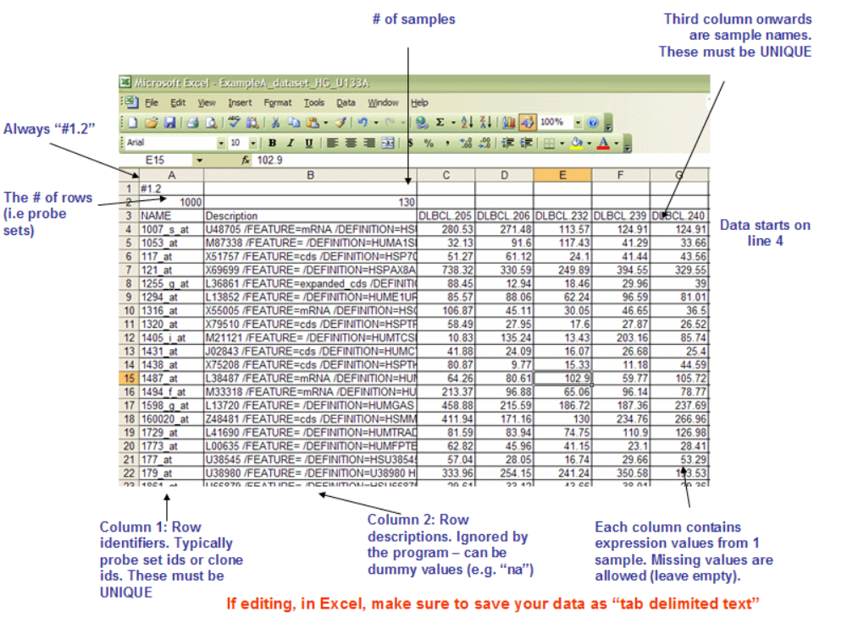
Preparing Expression dataset file (.gct format)

Slide 21
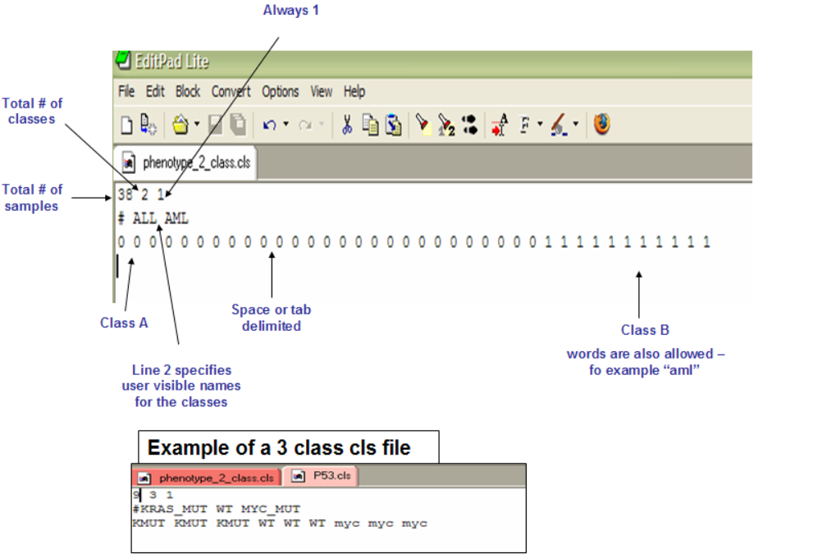
Preparing Phenotype label file (.cls format)

Slide 22
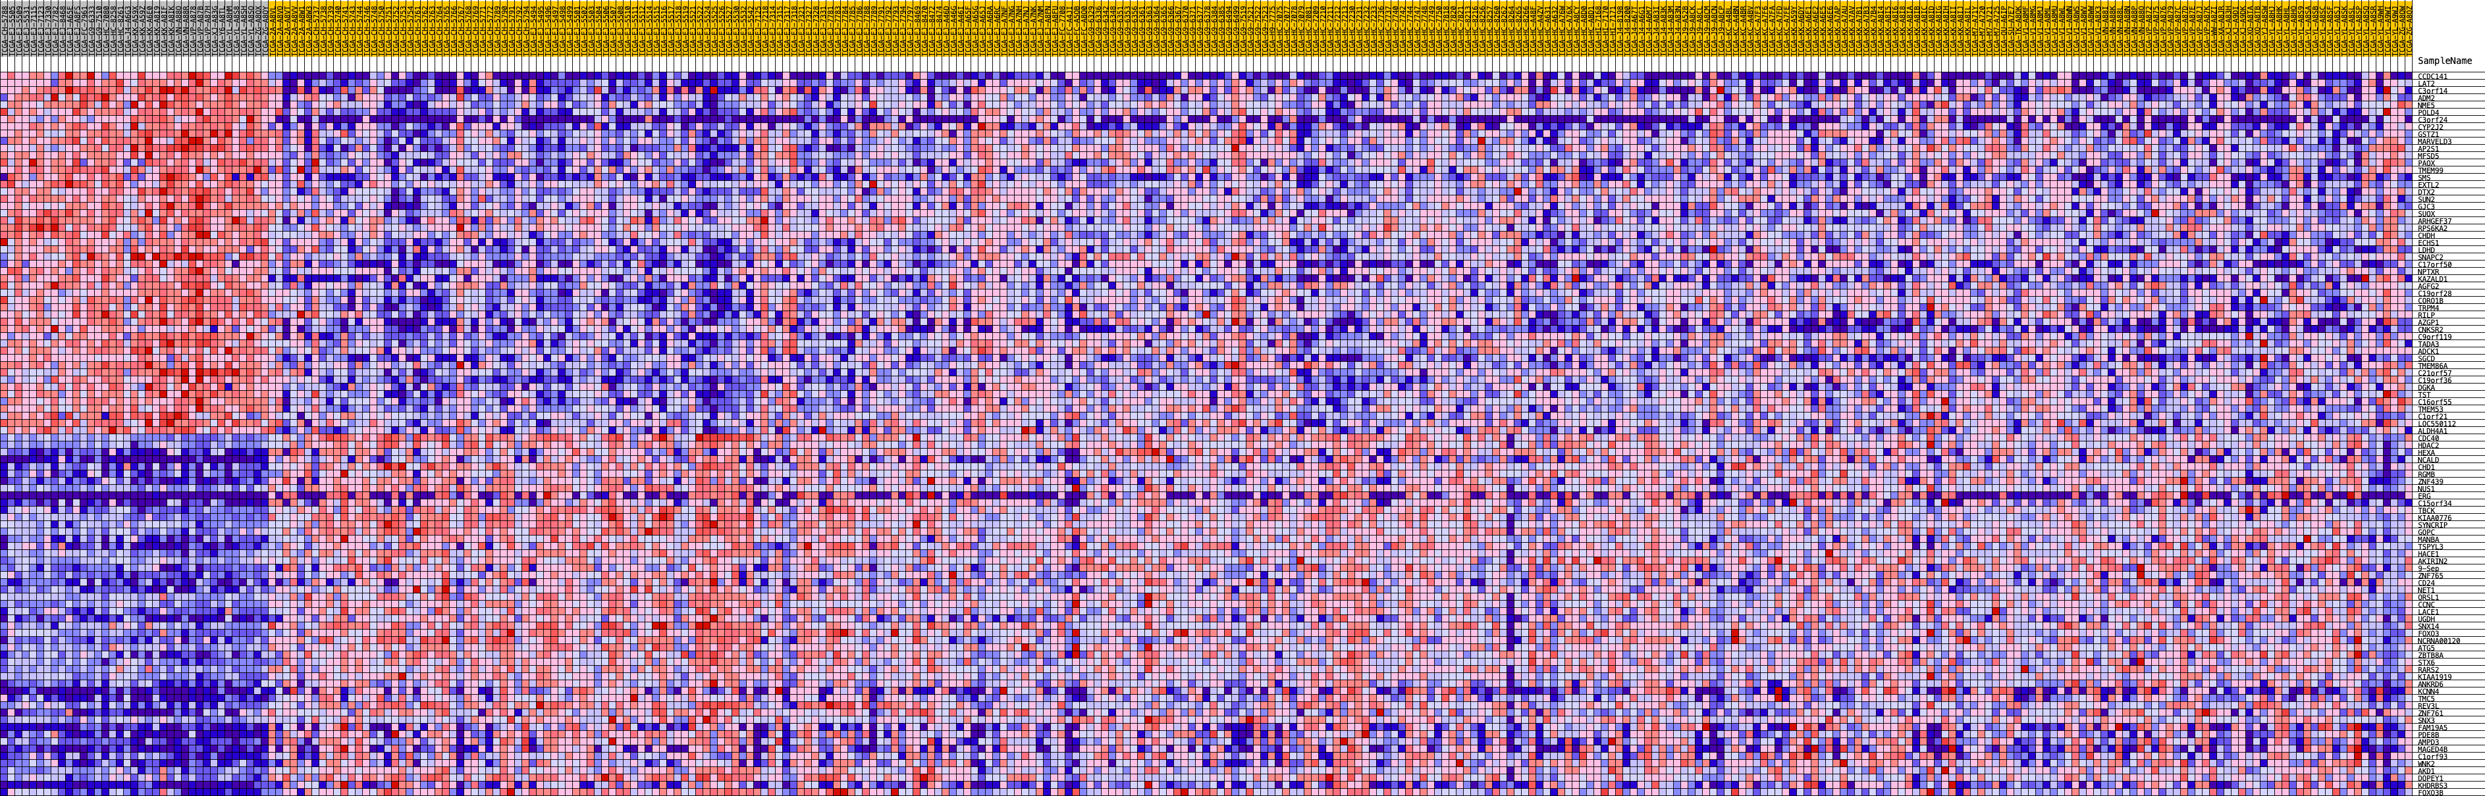
TCGA Prostate Cancer Patient Data Example
- RNA seq -
Mutant
Wild Type
In this example, we separated the patient population into two phenotype groups:
- Mutant SPOP protein
- Wild Type SPOP protein

Slide 23
